Slide 1
Building for the future
Building for the future
Business case for CCPI focussing on risk, compliance and related governance
Business case for CCPI focussing on risk, compliance and related governance
INSERT YOUR LOGO HERE

Slide 2
INSERT YOUR LOGO HERE
Content
Current and on-going context Challenge and Change in the Construction Product Manufacturing sector
Business case for CCPI and ethical leadership: Focusing on risk, compliance and related governance Delivering resilience, productivity and growth
Our response Strategic planning and key actions

Slide 3
INSERT YOUR LOGO HERE
Executive summary
Challenge and change across the construction product sector is bringing major ethical, risk, compliance and governance issues to the fore
Increasing regulation, increasing customer expectation and the potential for increasing liability represents risk and also opportunity for the business
To ensure a place in the future for our business, we need to prioritise governance, risk and compliance and put the Code for Construction Product Information (CCPI) and ethical leadership and culture at the heart of what we do
By doing so, we will increase resilience, enhance productivity and fuel growth
Next steps:
Understand our risk and exposure in this current context and update systems and processes across product lines and services
Pursue CCPI verification and bring market advantage for our brands and show we are part of the solution

Slide 4
INSERT YOUR LOGO HERE
CURRENT AND ONGOING CONTEXT

Slide 5
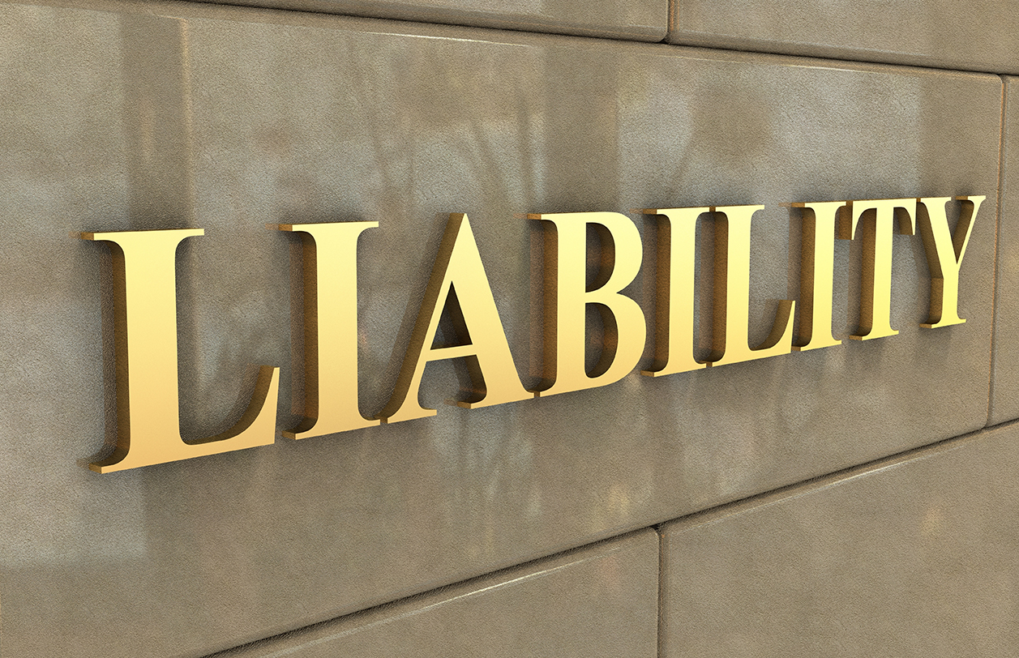
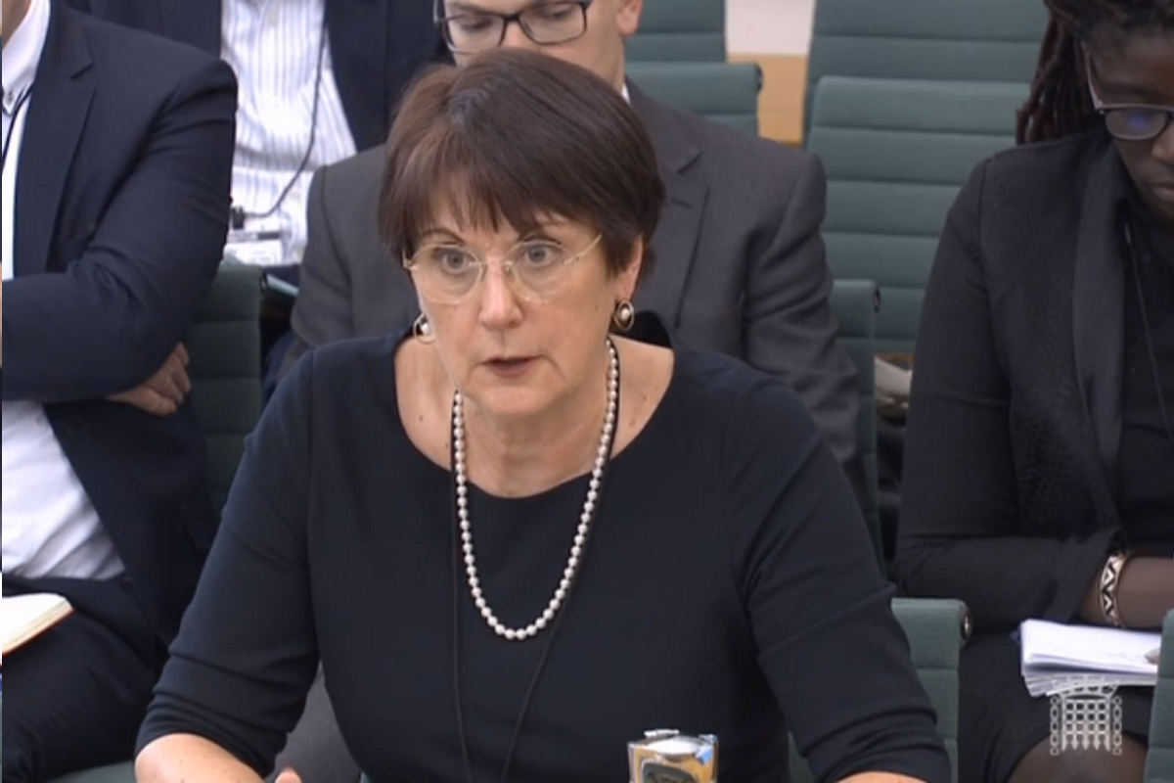
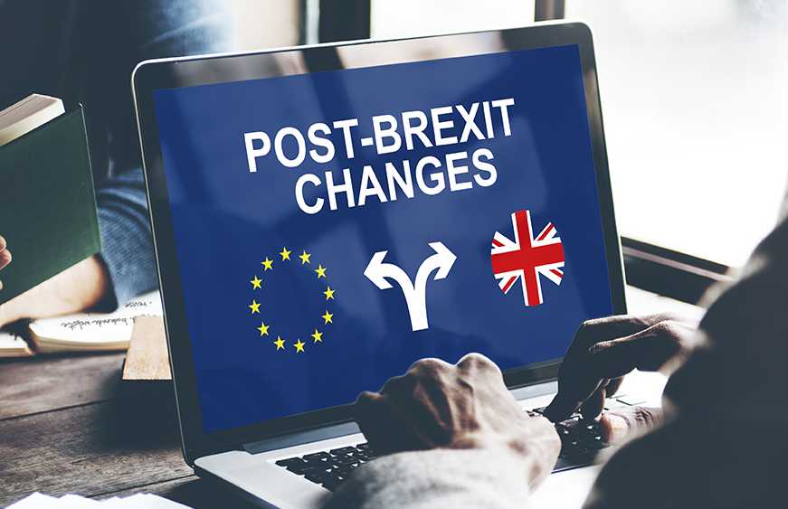
INSERT YOUR LOGO HERE
ASSURANCE
CHALLENGE AND CHANGE
Notes:
Current context and background:
In the period following the Grenfell Tower tragedy the construction sector and the construction product manufacturing industry has been at the centre of negative and damaging debate and media discourse.
Fallout from the tragedy is resulting in actors in the construction sector increasingly seeking to divest risk.
Considerable change to procurement and requirements in relation to installation is being developed and implemented. Customers – contractors, users and specifiers are requiring substantially more information and assurance.
In her report into the Grenfell tragedy Dame Judith Hackitt’s key recommendation focussed on the need for a fundamental change to the culture and leadership of the industry and a move away from the profit first behaviours that cause a race to the bottom on price and quality. Additionally, Dame Judith’s recommendations, (recommendation 7.6 a-c), included the establishment of a new National Construction Product Regulator and increased market surveillance. The Government accepted these recommendations. In 2021 the new regulator was announced.
We know that new, more stringent construction product regulations will be brought in, including with a searing focus on the safety of products and clarity and probity required of product claims and product information management.
We will need to understand more about where our product goes, how used, what our customers say and that we are not only making no misleading claims but that we are fully supporting the product and services we offer with the information that is clear, accurate, up-to-date, accessible and unambiguous.
All of this increases our risk of liability and non-compliance. Adding to this, post-Brexit, we see regulatory divergence from Europe and the need to manage for this. Environmental Social Governance including issues relating to carbon net zero and sustainability are all demands which will require increased governance, compliance and innovation.
As a critical part of the solution to the pressing need for manufacturers to be able to provide greater assurance in relation to product information, the Code for Construction Product Information (CCPI) was established.
This has been welcomed by Dame Judith Hackitt and the new regulator as making an important contribution to addressing some of the major issues the industry.
Verified conformance to the CCPI will provide third-party verification that our product information can be relied upon, now and in the future, by specifiers, installers and users. The scheme is now open for companies to register and use the verification processes.
We are working in a challenging and changing environment and to build a place for our business into the future we need to respond by prioritising product safety and information governance, risk and compliance. We need to put the Code for Construction Product Information (CCPI) and ethical leadership and culture at the heart of what we do.

Slide 6
INSERT YOUR LOGO HERE
Examples of headlines about the industry…
Makers of Grenfell cladding abused testing regimes, inquiry told The Guardian Nov 2020
Grenfell fire: focus shifts to possible criminal convictions as inquiry ends The Guardian Nov 2022
Product manufacturers must regain confidence Building Nov 2020
Gove turns on suppliers as 35 developers sign safety pledge Construction Enquirer Feb 2022
Pay up or you'll be banned: Gove orders cladding firms to foot the bill Daily Mail Jan 2022
Gove vows to pursue material suppliers for building safety cost Construction Enquirer Apr 2022
Notes:
The industry is under fire and criticism publicly. Here are some examples of the industry hitting the headlines over the past few years. This and more like it illustrate the environment in which we are working and where all actors are seeking to increasingly divest risk.

Slide 7
INSERT YOUR LOGO HERE
We are responsible for every product we invoice
‘Those who design, build, manage, modify or in other ways have an
influence on the integrity of buildings – especially those who are in
multiple occupancy – all need to feel responsibility for delivering
quality and safety and they need to be held accountable.’
Dame Judith Hackitt DBE
Notes:
We must consider this critical fact: We are responsible for every product we invoice. That means fully understanding about the product, how it is used, where it is used and ensuring that all of our information, systems and processes that support its sale and installation are robust.

Slide 8
INSERT YOUR LOGO HERE
BUSINESS CASE FOR CCPI AND ETHICAL LEADERSHIP

Slide 9
INSERT YOUR LOGO HERE
Our response? In the current context, there is a clear business case for the need to focus on risk, compliance and related governance and to embed the Code for Construction Product Information and ethical leadership and culture
What is the ROI? We can address our risks and exposure and bring tangible business benefit by increasing
RESILIENCE
PRODUCTIVITY
GROWTH
RESILIENCE
GROWTH
PRODUCTIVITY
REPUTATION MANAGEMENT
STRENGTHENS BRAND
EMPLOYEE SATISFACTION
REDUCED SUPPLY CHAIN RISK
MARKET DIFFERENTIATION
POSITIVE STAKEHOLDER RELATIONS
REGULATORY COMPLIANCE
STRATEGIC AGILITY
OPERATIONAL EFFICIENCY
BUILDING FOR THE FUTURE
BUSINESS CASE FOR CCPI AND ETHICAL LEADERSHIP
Notes:
Our response? In the current context there is a clear business case for the need to focus on risk, compliance and related governance and to embed the Code for Construction Product Information and ethical leadership and culture
What is the Return on our Investment:
We can address our risks and exposure and bring tangible business benefit by increasing our resilience, productivity and growth.
It is important to see not only the critical need for us to address these matters but also that there is substantial benefit and return on investment for the company by increasing our resilience, productivity and growth through our actions.
Compliance is a not negotiable license to operate. We need to be prepared for increased regulation following the Grenfell Tragedy and to meet sustainability needs. We can ensure we avoid direct costs – ie fines and protect future earnings (ie helps avoid reputational damage).
By engaging our supply chain in ethical requirements, we can put both parties on a stronger footing, reduce exposure to an issue we may be unaware of and reduce volatility too. It can lead to greater partnership and potential enhanced performance.
On reputational management: Warren Buffett famously said: “It takes 20 years to build a reputation and five minutes to ruin it”.
The stark reality of the Grenfell Tower tragedy loss of 72 lives, and shocking admissions to the inquiry, provide compelling examples of damaged reputations and what we are seeking to avoid.In relation to increasing our productivity: adhering to the CCPI will benefit our operational efficiency. By streamlining management system and process around Product Information Management we will reduce time and effort for employees and avoid repetition and time wasted correcting mistakes.
Plus, knowing our customers and stakeholders will provide us with insight that will help us serve them better and in turn increase our performance. Engaging our employees in this will increase satisfaction and help us avoid costs of recruitment but when we do have to bring in new staff, embracing ethical culture and leadership will also help us with attracting the best talent. In terms of our actions helping to increase growth, it will do so by first and foremost strengthening our brand. That is vital at this time when the industry is so publicly criticized. In the increasingly complex post-Grenfell tragedy landscape, brands with integrity will win customers who increasingly need assurance. And how we can provide that assurance is to adhere to the CCPI and pursue independent verification for our product information. The CCPI provides us with the opportunity to differentiate ourselves in the marketplace and show we are part of the solution.

Slide 10
INSERT YOUR LOGO HERE
Opportunity and need…investment
What is the scope of the investment required? Potential costs to cover:
• Time/salary for a project lead and compliance manager functions.
• The cost of CCPI registration and verification which is dependent on annual turnover and company size and size/type of product sets with information to verify. We can ascertain these figures from the CCPI website.
• Depending on our capability we may need to invest in IT to support effective Product Information Management.
• It is recommended that this project has a Board sponsor.
RESILIENCE
GROWTH
PRODUCTIVITY
REPUTATION MANAGEMENT
STRENGTHENS BRAND
POSITIVE STAKEHOLDER RELATIONS
REDUCED SUPPLY CHAIN RISK
MARKET DIFFERENTIATION
OPERATIONAL EFFICIENCY
REGULATORY COMPLIANCE
STRATEGIC AGILITY
TALENT ATTRACTION & RETENTION
BUILDING FOR THE FUTURE
BUSINESS CASE FOR CCPI AND ETHICAL LEADERSHIP
Notes:
THESE ARE SUGGESTED ROLES OR INVESTMENT YOU MAY MAKE TO SUPPORT THIS PROJECT.

Slide 11
INSERT YOUR LOGO HERE
What our competitors and other manufacturers are doing…
Insert any examples you can provide here
Are competitors engaging with third-party verification programs such as CCPI which will give them competitive advantage
Notes:
THIS IS A SUGGESTED SLIDE. PLEASE INSERT ANY EXAMPLES OF RELEVANT COMPETITORS ACTION IF YOU HAVE THEM.

Slide 12
INSERT YOUR LOGO HERE
OUR RESPONSE

Slide 13
INSERT YOUR LOGO HERE
Success criteria
We update our processes and systems so that we are confident that our products and services that we sell are all underpinned by robust management processes, competency, training, understanding and knowledge/awareness.
We achieve independent verification against the Code for Construction Product Information.
We utilise CCPI verification to promote our business with customers, clients, insurers, procurement frameworks, shareholders etc…
Notes:
3 clear criteria so that we know we have succeeded:
We update our processes and systems so that we are confident that our products and services that we sell are all underpinned by robust management processes, competency, training, understanding and knowledge/awareness.
We achieve independent verification against the Code for Construction Product Information.
We utilise CCPI verification to promote our business with customers, clients, insurers, procurement frameworks, shareholders etc…

Slide 14
INSERT YOUR LOGO HERE
3 recommended next steps
Use our leadership to support change
In the current context we are working in conduct a high-level risk and exposure analysis to target and inform risk, compliance and related governance actions
Pursue CCPI verification – register to at www.cpicode.org.uk, appoint a lead, sign up to go through the assessment process
Notes:
So what do we need to do to make this happen:
We need our leadership to support the change and there are some suggestions on the next slide as to things that are important for our leadership to be supporting us on and promoting to help embed the right approaches into our organization.
We conduct a high level survey of customers and staff so we can understand any exposure we have and help us target remedy actions. Where there are areas that need development and remedy we implement correct/remedy and implement necessary change. If it there is a substantial issue we would bring that back to the Board.
We register with the CCPI and pursue verification of our product set information. The CCPI system is live now and manufacturers are already starting to go through the process.

Slide 15
INSERT YOUR LOGO HERE
1. Leadership to support change
Visibly lead on sharing good practice and learnings internally and share externally too
Encourage employees to stay up-to-date on technical knowledge and industry developments
Encourage line managers to talk about errors and issues etc
Signify to the business no negative consequences to raising if there is a problem/something unsafe/information or action that is incorrect
Ensure we are confident in our inspection, audit and review and give adequate time and encouragement to learn and enact necessary change
Ensure we use third party verification for market advantage
Hold our risk management to account: ensure it is not a ‘box-ticking’ exercise
Engage with our stakeholders and feedback to the business
Notes:
Here are some suggestions on key actions our leadership can be promoting and supporting to help embed the right approaches into the organization.
It is really about opening up channels of communication. Visibly leading on sharing good practice and encouraging learnings internally and share externally too. Making our culture a culture where employees are encouraged to stay up-to-date on technical knowledge and industry developments and line managers are encouraged to talk about errors and issues etc
Our employees, the business as a whole need to be clear that there are no negative consequences to raising if there is a problem/something unsafe/information or action that is incorrect.
Plus of course we want to be confident in our inspection, audit and review and make sure we are giving adequate time and encouragement to learn and enact necessary change.
We want to build on this and ensure we are using third party verification for market advantage - such as the CCPI verification.
We know that new regulation will likely have some sort of risk assessment element, Dame Judith Hackitt raised that in her recommendations. So we need to ensure we hold our risk management to account and make sure it is not a ‘box-ticking’ exercise.
Also important will be to make the most of our stakeholder input, from customer complaints to compliments we can use that information to inform our work and action to embed the right behaviours in our company.

Slide 16
INSERT YOUR LOGO HERE
2. Understand our risk and exposure
Need to conduct a high-level risk review looking at all product lines and services and supporting processes
Aim to enhance technical and process compliance
Notes:
Should review: Processes: Training, order process management, claims management, terms and conditions, product information change management, customer complaints handling
Approach to customer advice: Specifications, Estimations, Design Guidance, Value Engineering, Substitution etc
Approach to the information we provide for products: technical product information, claims made across specific brands, broader marketing claims

Slide 17
INSERT YOUR LOGO HERE
2. Understand our risk and exposure
Ask our staff, customers and stakeholders
Conduct a survey to:
Understand our staff’s everyday experience and how we can support them
Ask our customers and stakeholders their experiences
Understand where our product goes and how it is used
Understand customer complaints
Notes:
Through our survey we should seek to answer the following questions:
Awareness: Do staff in relevant parts of the organisation have necessary awareness and knowledge to handle questions coming to them about our product?
Knowledge: Do we understand our products? Do the necessary people have the information and skills they need to engage with contracts, sales or as specialist advisers
Motivation to stay informed: Are we motivating them to build their knowledge?
Legal issues: Are we confident T and Cs, contracts are correct, up-to-date, enforceable
Communications: Are we confident in the claims we make, are they underpinned with evidence, is our marketing up-to-date (e.g. symbols/logos/photos/links between websites, links to brochures etc), have we compared with CCPI words and phrases to avoid

Slide 18
INSERT YOUR LOGO HERE
3. Pursue CCPI verification
CCPI process is confidential and has clear steps:
CCPI will help us understand our culture and leadership
Check our product information management systems against the 11 clauses of the Code
Corroborate that our product information is clear, accurate, up-to-date, accessible and unambiguous against the clauses of the Code
Check our performance statements made for product information against formal certification, classification and/or testing
Notes:
We believe that pursuing CCPI verification will help us ensure we have the right processes in place and will bring the advantages we have outlined for the business.
It is a confidential process and has clear steps.
- CCPI will help us understand our culture and leadership
- Check our Product Information management systems against the 11 clauses of the Code
- Corroborate that our Product Information is clear, accurate, up-to-date, accessible and unambiguous against the clauses of the Code
Check our performance statements made for Product Information against formal Certification, Classification and/or Testing

Slide 19
INSERT YOUR LOGO HERE
CCPI offers advantages with clients and customers
Independent assurance is critical for marketing
Customers want independent verification
Specifiers will increasingly require independent verification and CCPI
Major contractors want greater assurance - CCPI is under consideration to be included in contracts, SLAs and Common Supplier Frameworks
Major Procurement Frameworks are already requiring specific assurance schemes, it is expected CCPI will be included, (e.g. Crown Commercial Services, Homes England, Scape)
Notes:
We believe CCPI offers advantages with clients and customers.
We know that independent assurance is critical for marketing – particularly in the current climate.
We know that customers increasingly want more information and will value independent verification. At the moment we understand that CCPI is under consideration to be included in procurement frameworks and contracts. We want to ensure we are on that requirement.

Slide 20
INSERT YOUR LOGO HERE
CCPI offers advantages with insurers
Over the last 5-6 years we have seen insurance premiums increase
The market has seen increasing costs of PII of between 20% and 400%
Dame Judith Hackitt has said, “The way to put this right is to “regain [the insurance industry’s] confidence.”
CCPI can help – independent accreditation can help build trust and provide assurance to keep insurance premiums down
Notes:
We know that the insurance sector has really led some of the demands and changes by requiring standards often above regulation. We also know insurance costs have gone us. We believe that independent third party verification will be helpful to proving to our insurers that we are part of the solution to the issues that are being raised about the industry and therefore we have a lower risk profile.

Slide 21
INSERT YOUR LOGO HERE
CCPI publicly recognised and supported
Dame Judith Hackitt and the Industry Safety Steering Group reporting to the Government has recognised and applauded the CCPI
”I have written here previously about the great progress which has been made with the Building a Safer Future Charter and the Code for Construction Product Information and we are now seeing leading organisations sign up and make a serious commitment.”
OPSS, responsible for the set-up and development of the New Construction Product Regulator, supports the aim of the CCPI and recognises the benefits it can bring to helping the industry deliver on the change required
Notes:
CCPI has been successful and gaining positive recognition from Government ministers, Dame Judith Hackitt herself and the OPSS that is housing the new National Construction Product Regulator has said that it supports the aim of the CCPI and recognises the benefits it can bring to helping the industry deliver on the change required.

Slide 22
INSERT YOUR LOGO HERE
Market advantage from the CCPI
Insurers value third-party verification
Clients and customers are increasingly asking for more assurance
When further post-Grenfell regulation comes in, CCPI will support our regulatory readiness
We can use the CCPI logo on our product sets to stand out from the crowd
Prove that we are a company committed to ethical leadership and culture
Provide third-party verification that our product information can be relied upon, now and in the future, by specifiers, installers and users
Notes:
In summary we believe we can gain market advantage from CCPI.
Insurers value third-party verification
Clients and Customers are increasingly asking for more assurance
When further post-Grenfell regulation comes in, CCPI will support our regulatory readiness
We can use the CCPI logo on our product sets to stand out from the crowd
Prove that we are a company committed to ethical leadership and culture
Provide third-party verification that our Product Information can be relied upon, now and in the future, by specifiers, installers and users

Slide 23
INSERT YOUR LOGO HERE
Timeframes and incentives… START NOW!
CCPI is now open for assessments for verification
For 2023, CPA Members will get priority in the waiting list for assessment
New Construction Product Regulation post-Grenfell is expected early/mid 2024
Notes:
Next 18 months will be important. The Grenfell Inquiry report is expected late 2023. There will be media and follow up alongside the police investigation and any criminal prosecutions later 2024 onwards. The Building Safety Act secondary legislation is still in development and expected to be brought in in 2024. New Construction Product Regulation post-Grenfell is expected early/mid 2024. We know these timescales can and do move. We also now internal change takes time. Therefore, it is recommended we need to pursue the recommended actions now.
Next 18 months will be important…
Grenfell Inquiry report expected late 2023, criminal prosecutions later
The Building Safety Act secondary legislation still in development expected 2024

Slide 24
INSERT YOUR LOGO HERE
APPENDICES/ ADDITIONAL SLIDES
Notes:
These are additional slides which you may wish to consider including or that you can keep for your reference

Slide 25
INSERT YOUR LOGO HERE
Increasing resilience through regulatory compliance
Compliance is a not negotiable license to operate
We need to be prepared for increased regulation following the Grenfell Tragedy and to meet sustainability needs
We can ensure we avoid direct costs – ie fines
Regulation can provide a level playing field for us to compete on
It can help with internal alignment – we all need to know what we are doing and work to the same standard
We can protect future earnings (ie helps avoid reputational damage)
Investing in compliance approaches helps avoid atrophy, inefficiencies and increased risk of failure creeping in
RESILIENCE
REGULATORY COMPLIANCE
BUSINESS CASE FOR CCPI AND ETHICAL LEADERSHIP

Slide 26
INSERT YOUR LOGO HERE
Increasing resilience through reduced supply chain risk
This creates a positive halo-effect - engaging supply chain in ethical requirements puts both parties on a stronger footing
Full knowledge of supply chain gives us greater confidence
Will help reduce exposure to an issue we may be currently unaware of
Understanding our supply chain more closely will help reduce volatility of supply
Can lead to greater partnership and potential enhanced performance
In the current economic and social climate this is a must
RESILIENCE
REDUCED SUPPLY CHAIN RISK
REGULATORY COMPLIANCE
BUSINESS CASE FOR CCPI AND ETHICAL LEADERSHIP

Slide 27
INSERT YOUR LOGO HERE
Increasing resilience through reputation management
RESILIENCE
The stark reality of the Grenfell Tower tragedy loss of 72 lives, and shocking admissions to the inquiry, provide compelling examples of damaged reputations
“It takes 20 years to build a reputation and five minutes to ruin it” Warren Buffett
We will benefit from enhanced brand equity as a company building a reputation for being in front in terms of managing issues, preparing for change and proactively managing risk
And resilience breeds resilience: companies that have positive reputations suffer less when issues do happen
Trust Quote
REPUTATION MANAGEMENT
REDUCED SUPPLY CHAIN RISK
REGULATORY COMPLIANCE
BUSINESS CASE FOR CCPI AND ETHICAL LEADERSHIP

Slide 28
INSERT YOUR LOGO HERE
Increasing productivity through operational efficiency
Streamlining management system and process around Product Information Management will reduce time and effort for employees
Avoids repetition and time wasted correcting mistakes
Stops Information Management being a ‘cottage industry’ and makes it an effective business process
Frees up employee time to do their day jobs properly or contribute to innovation
PRODUCTIVITY
OPERATIONAL EFFICIENCY
BUSINESS CASE FOR CCPI AND ETHICAL LEADERSHIP

Slide 29
INSERT YOUR LOGO HERE
Increasing productivity through positive stakeholder relations
Knowing our customers and stakeholders provides insight that will help us serve them better and in turn increase our performance
The work we are doing reaches across all key stakeholder communities: customer, employee and supplier
We will understand them more and can calibrate change accordingly to enhance performance
This will benefit innovation and service refinement
Stronger customer relationships will lead to greater customer loyalty, growth and sales
PRODUCTIVITY
STRONGER CUSTOMER RELATIONS
OPERATIONAL EFFICIENCY
BUSINESS CASE FOR CCPI AND ETHICAL LEADERSHIP

Slide 30
INSERT YOUR LOGO HERE
Increasing productivity through employee satisfaction
PRODUCTIVITY
Great Place To Work® research (2022) has found that when employees feel proud to work at a company, they are:
6 times more likely to endorse their workplace to others
2 times more likely to want to stay with the company for a long time
1 times more likely to say it’s a great place to work
This will help us retain talent and reduce costs of replacement
Ethical leadership and culture can help attract new talent
High employee satisfaction = better performance
EMPLOYEE SATISFACTION
STRONGER CUSTOMER RELATIONS
OPERATIONAL EFFICIENCY
BUSINESS CASE FOR CCPI AND ETHICAL LEADERSHIP

Slide 31
INSERT YOUR LOGO HERE
Increasing growth through strengthening our brand
In the increasingly complex post-Grenfell tragedy landscape, brands with integrity will win customers who increasingly need assurance
Higher level of performance is perceived from a company with a reputation supported by integrity (Doing well by doing good 2015)
Purpose led brands outperform other brands e.g. Unilever results 2019 showed purpose led brands grew 69% faster than the rest of the business, compared to 46% in 2017
GROWTH
STRENGTHENS BRAND
BUSINESS CASE FOR CCPI AND ETHICAL LEADERSHIP

Slide 32
INSERT YOUR LOGO HERE
Increasing growth through market differentiation
”Contrary to what most people believe, trust is not some soft, illusive quality that you either have or you don’t; rather, trust is a pragmatic, tangible, actionable asset that you can create”. Stephen Covey
Independent third-party verification is a very effective way of providing assurance and showing trustworthy system/process/information
The Code for Construction Product Information (CCPI) provides us with the opportunity to differentiate ourselves
GROWTH
MARKET DIFFERENTIATION
STRENGTHENS BRAND
BUSINESS CASE FOR CCPI AND ETHICAL LEADERSHIP

Slide 33
INSERT YOUR LOGO HERE
Increasing growth through developing strategic agility
GROWTH
Our actions to embed ethics will enable us to:
Anticipate what our firm needs
Adapt our systems and processes to be fit for purpose
Act to deliver refined product and/or innovation to reach new markets or new customers
STRATEGIC AGILITY
MARKET DIFFERENTIATION
STRENGTHENS BRAND
BUSINESS CASE FOR CCPI AND ETHICAL LEADERSHIP

Slide 34
INSERT YOUR LOGO HERE
Key questions to answer
Awareness: Do staff in relevant parts of the organisation have necessary awareness and knowledge to handle questions coming to them about our product?
Knowledge: Do we understand our products? Do the necessary people have the information and skills they need to engage with contracts, sales or as specialist advisers
Motivation to stay informed: Are we motivating them to build their knowledge?
Legal issues: Are we confident T and Cs, contracts are correct, up-to-date, enforceable
Communications: Are we confident in the claims we make, are they underpinned with evidence, is our marketing up-to-date (e.g. symbols/logos/photos/links between websites, links to brochures etc), have we compared with CCPI words and phrases to avoid

